Slide 1
Investing Basics
Document Created 11/6/2015
Last Updated 9/18/2016

Slide 2
Overview
Personal Planning and Career Development (Slides 3-8)
Investing (Slides 9-43)
Equities (Slides 10-33)
Bonds (Slide 34-36)
Markets, Funds and Portfolios (Slides 37-49)
Wall Street (Slides 50-70)
Bibliography (Slide 71)

Slide 3
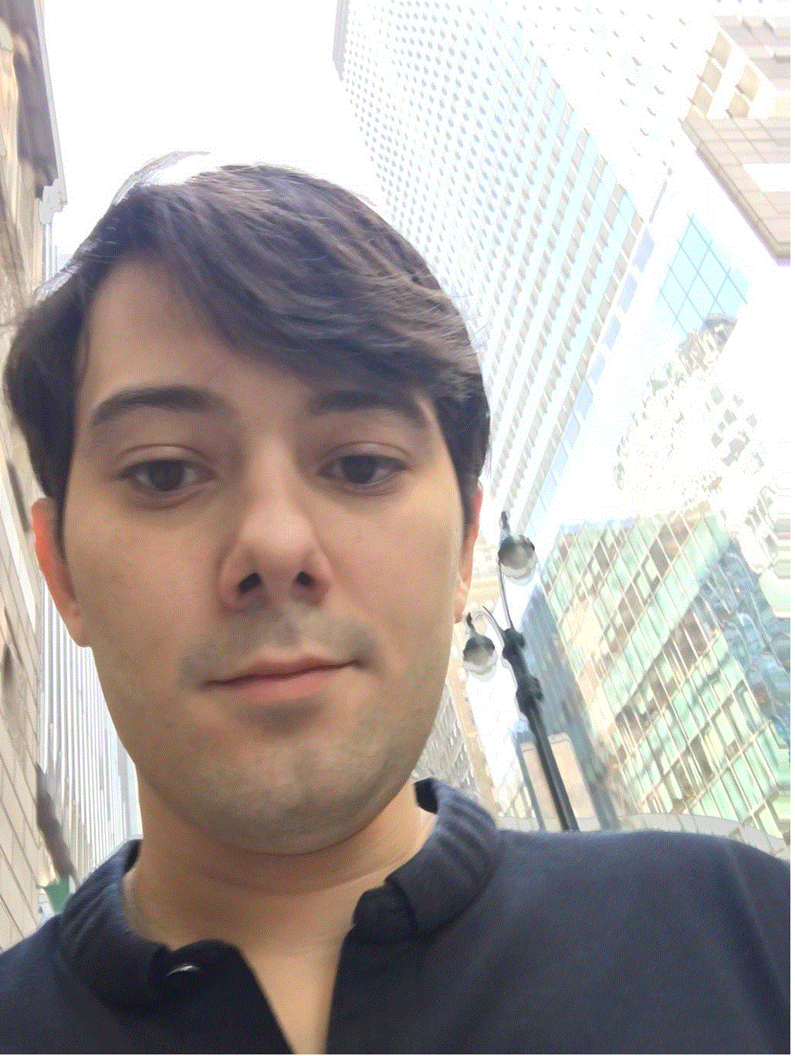
Personal Logical Roadmap – My Story
What am I trying to accomplish? (financial goal?)
BE REALISTIC – YOU ARE POOR (15-year-old realization)
You can’t turn $50,000 into a lot of money (even with a very high rate of return)
Model out a conservative rate of return – large return strategies exist briefly – mostly discovered by luck and not by a systematic approach
MOST OF YOUR INCOME WILL BE FEE-BASED (SALARY) FOR A LONG TIME
You can make more money advising people with capital than trying to grow your own capital
No risk – get paid
Your advice/approach needs to be worth something (to someone else) – specialize in something
Expertise is far scarcer than wealth
Eventually you can make money investing your own money and others
You can’t be an expert in something overnight – takes 5 to 10 years

Slide 4
Planning Your Career
Why am I trying to accomplish this goal (being a good investor)?
Soul-searching and true introspection
Is what I want to do sustainable? Is it a “micro-arbitrage”?
What useful skills will I have if the current opportunity disappears? Avoid style-dependency
What are my strengths and weaknesses?
Socratic and honest attitude
Selecting a mentor/guide
Psychology

Slide 5
How do I teach myself?
Learn from other investors (Biographies, News Articles, Interviews)
Warren Buffett & Charlie Munger (Berkshire Hathaway) – value investor/private equity
Jim Simons (Renaissance Technologies) – quantitative investor
Seth Klarman (Baupost Group) – value investor / distressed debt
Steve Cohen (SAC) – equity trader / fund of funds
Julian Robertson (Tiger) – value investor / fund of funds
“If you buy 100 great companies and short 100 lousy companies and you don’t make money at the end of the year, you need a new job”
George Soros (Quantum) – FX trader / macroeconomics
Carl Icahn (Icahn) – activist investor / value investor / private equity
Louis Bacon
Paul Tudor Jones
Joe Lewis – FX trader
Ray Dalio (Bridgewater)
Michael Steinhardt – No Bull
Larry Tisch
Real Estate, Private Equity
Learn about learning (logic, math, science and other areas will assist)
Learn laterally relevant fields (history, literature)

Slide 6
Theory and Text
Journal of Finance
Scholastic level erudite collection of papers that are inscrutable
Damodaran: http://people.stern.nyu.edu/adamodar/
Finance → Brealey & Myers
A whole major in one present value formula
Not technical, much more philosophical
Phil Fisher – Common Stocks and Uncommon Profits
Seth Klarman – Margin of Safety

Slide 7
Most People Should Not Invest
I view investing as a “zero-sum” game
The old adage about not being able to spot the sucker at the poker table applies—unless you are willing to work as hard and become as well-trained as the most successful investment groups, why should you assume you will win at a very contested game?
Do not despair—you can get some return by investing in excellent investment managers—but do not try this at home!
Focus on creating wealth in your competency instead of gaining an additional competency (investing skill)

Slide 8
Psychology
Self-Actualization
Centering
Fear
“How big of an impediment is psychological pain to your progress?”
Ray Dalio’s Principles (www.principles.com)
“It isn’t easy for me to be confident that my opinions are right.”
“Bad opinions can be very costly.”
“The consensus is often wrong, so I have to be an independent thinker.”

Slide 9
Asset Classes
Equity
Public Equity
Private Equity
“Credit”/Debt
Currency
Commodities
Real Estate
“Macro”
Funds?
Others

Slide 10
Equities Overview
Almost all corporate activity on the planet is done in the aim of creating equity value (or stockowner value) – through increased stock value or dividends
Big public companies (Walmart, Google, etc.)
Sole, privately-held proprietorship (local deli)
Equities/Corporations are a useful corporate organization option because they allow for business expansion furnished by the proceeds of selling new equity
New equity is dilutive to old equity owners but provides cash
Equities are very efficient and portable (vs. partnership interests). They are easily listable, tradeable and sellable

Slide 11
Equities Example: A New Company
Imagine you and your partners have decided to start a new business, Deez.Com
You are the CEO of Deez, and your two partners are the CFO and General Counsel
You have decided to split the ownership of the company into 50% for yourself and 25% each for your two partners
Incorporating Deez.Com in Delaware with a law firm’s assistance, you decide to have 1,000,000 shares outstanding of Deez.com
You own 500,000 shares of Deez.com
Your two partners each own 250,000 shares of Deez.com
Of course, you have not yet contributed any cash (capital) to the company
To do so, you must seek investors!
Your pitch is exciting and investors have agreed to invest $1,000,000 into the company at a price of $1 per share
You bargained very hard for $2 per share, and the investors proposed $0.50 per share, but you agreed on $1
Deez.Com will now issue one million new shares to the investors
The new capitalization of the company is:
1,000,000 shares for the new investors
500,000 shares for you
250,000 shares for the CFO
250,000 shares for the General Counsel
2,000,000 TOTAL SHARES OUTSTANDING
Notice how your stake in the company dropped from 50% to 25% after the capital raise—you were DILUTED in the transaction

Slide 12
Equity (Stocks) Basics
The first six things I look at for any equity
1. Stock Price
2. Shares Outstanding
3. Market Capitalization (Stock Price X Shares Outstanding)
In essence, this is the value of the company!
(4. Cash – 5. Debt) or Net Cash
6. Enterprise Value
This is the value of the company on a “cash-neutral” basis

Slide 13
Financial Statements
“The Holy Trinity”
Income Statement – Total operational results for any given period
Revenue Recognition (“rev rec”) - GAAP
Revenue – Expenses = Profit/Losses
Matching Principle and other GAAP applies – may not reflect cash reality
Balance Sheet – A snapshot (like a photograph) of a company’s financial position (balances) at any given time – usually at the end of an important period such as a quarter or year
Assets – Liabilities = Stockholders’ Equity
Cash Flow Statement – Reconciles GAAP Income Statement to Cash

Slide 14
Illustrated Concept of Enterprise Value
Company A has 10 million shares outstanding.
Company A stock recently has been fluctuating between $20 and $21.
The market capitalization of Company A is therefore approximately $200,000,000.
The balance sheet of Company A shows $50,000,000 in cash and $25,000,000 in debt.
Therefore, the enterprise value of Company A is $175,000,000.
Another way to think of it is enterprise value is a “cash-neutral” market cap
Market Capitalization $200,000,000
Enterprise Value
$175,000,000
$50,000,000 cash
$25,000,000 debt
Company A “Capital Structure”

Slide 15
Accounting – The Language of Business
Generally Accepted Accounting Principles are our rules
FASB is the group that promulgates GAAP
Non-GAAP financials are sometimes useful!
Excluding “one-time” and especially “non-cash” costs can give us a better understanding of a business
The Cash Flow statement is critical to reconcile the expensing or capitalization (putting an expense on the balance sheet instead of the income statement) of costs

Slide 16
Accounting
Revenue Recognition – a difficult but important concept – when is revenue realized?
General concept is when title has passed and risk is born by purchaser
Cash need not be collected yet!
Matching Principle
Costs are recognized in the period they are incurred and matched to the revenue recognized
Non-Cash Expenses
Depreciation & Amortization
Writing off of a capital expenditure (D) and the writing off of an intangible asset (amortization)
Expenses: expensed or capitalized?
Some expenses are “capitalized” and they do not flow through the income statement!!!
Capital expenditures (long-term assets with over 12 months of usable life) will be capitalized on the balance sheet and recorded in the cash flow statement
Cash Flow vs. Net Income
Reconciled by comparing Cash Flow statement and Income statement
Consolidate all the income statements of the entities you own more than 50% of
VIE, MI

Slide 17
Balance Sheet
Assets – Liabilities = Stockholders’ Equity
Assets = Liabilities + Stockholders’ Equity
Liquidity
Current Assets/Liabilities = become cash within 12 months
Long-Term Assets/Liabilities become cash after 12 months or never
Order in liquidity
Accounts Receivable – Cash your customers owe you
Deferred Revenue – Product you owe your customers
Property Plant & Equipment (PP&E) – Assets with a useful life of longer than 1 year

Slide 18
Income Statement
Revenue Recognition
Cost of Goods Sold (COGS) – Direct and indirect (!) costs of the product recognized as revenue (can include people!)
Selling & Marketing – Promotional costs, including people!
Research & Development – Project costs, includes people
General & Administrative – Legal Costs, Audit Costs, Rent, Headquarters, Employees, etc.

Slide 19
The Value of a Company - Theory
Finance 101
Discounting cash flow series
Discount Rate is the embodiment of the concept that “a dollar today is worth more than a dollar tomorrow” – but how much?
What discount rate to use?
Risk = reward
Risk free rate
Equity risk premium
Bond markets, equity yields
Monitoring DR across potential investments
Why do this?
Forecasting those cash flows, assessing risk to cash flows is the job of an investor
“A company is worth the discounted sum of its cash flows from today until eternity”

Slide 20
Discounting Cash Flow
Why is one dollar today worth more than one dollar promised tomorrow?
Risk that you may not receive that dollar
Inflation (consider risk/benefit of deflation)
Opportunities to invest that dollar in higher-returning projects
Simple Example
Q: John is a NFL quarterback who believes he can return 5% per annum investing in bond funds. Should he take a $75 million upfront payment or a $25 million per annum payment for 3 years? Assume his probability of collecting over 3 years is the same as the upfront payment (not at risk)
A: The $75 million is vastly preferential as John will have $86.8 million ($75m X 1.05^3) at the end of three years, as opposed to only $82.5 million ($25m X 0.05 + $50m X 0.05 + $75m X 1.05) if he receives payment in installments. It is obvious to see that the ability to invest cash flow as soon as possible is desired

Slide 21
The Value of a Company - Practice
Bonds and Equities have a parity concept (Shkreli Theory)
Bonds have an annual “cash flow” in the same sense equities have net income that shareholders may claim. This cash flow is interest and the amortized principal (even if it is a balloon repayment)
Bonds are theoretically safer than equities as they are senior to equity in the repayment “waterfall”
However, for very large companies where the default risk is very low, the bonds and equity should have a much closer parity than in a riskier enterprise

Slide 22
Fundamental Research
Phil Fisher – Common Stocks and Uncommon Profits
“Channel Check”
Management
Update – Quarterly Conference calls and meetings
Press Releases – Read at least 1 year of prior releases and update your model with them
Sign up for company press releases OR create google alerts
Forecasting
Traditional
Lateral
True Costs / One-Time Costs / Economic Reality
The Opinion of Others
Ignore other investors
Ignore Wall Street research
Ignore TV/CNBC
Value vs. Growth / Risk

Slide 23
Fundamental Research - Expectations
1 hour – barely any familiarity with the company
Company history, current products, etc.
10 hours – slight familiarity with the company
Basic working model, etc.
100 hours – reasonable familiarity with the company
Listened to/met with management, etc.
1000 hours – decision-making familiarity with the company
It (should) take a lot of time and thinking before you make the decision to invest!

Slide 24
Fundamental Research - Forecasting
Revenue forecasts
Management guidance and other company results/guidance
Currency adjustments
Parallels
Relate something hard to forecast to some phenomenon that has happened in the past. E.g. transition from black & white TV to color TV might mirror the transition from TV ads to internet ads
Anything that is more realistic than a “law of larger numbers” forecast—avoid these
Surveys
Surveys are a very cheap way to keep your finger on the pulse of business

Slide 25
Primary Research
Relevant interviews/contacts (“Channel Checks” vs. “Due Diligence”)
Who they are
Current and former employees
Competitors
How to get them
Gerson Lehrman Group/similar “matchmaker” services
Linkedin/”smile and dial”
What to say
CIA/KGB interrogation methods
Phil Fisher, Common Stocks and Uncommon Profits (Chapter 2)
Secondary Research: Other People’s Research (Investment Banks, Investors, News articles)
Pitfalls: Misleading conclusions from poor sample size, confirmation bias, possible insider information

Slide 26
Capital Efficiency
Capital efficiency is a concept that compares a business’ required assets to generate profit with that profit
Is capital efficiency desirable?
Volatility
What does it mean to investors?
Some examples
Intel
Coca-Cola
Ford
WalMart
Facebook
Apple: 253%
Best Buy

Slide 27
Return Ratios
Return on Equity – ROE
What does it tell us about Brand/Moat
Return on Tangible Book – ROTB
Return on Assets – ROA
Return on Invested Capital – ROIC
Buffett Return

Slide 28
Ratios & Fundamental Research
Almost all of an equity analyst’s job is measuring long-term earnings potential
Short-term focus is problematic if myopic…
…but short-term results can give us hints on the long run (e.g. NOK missing earnings in 2000)
Barriers to competition are a significant part of this exercise
Warren Buffett defined the “m” word: “moat”, to describe assets with protection from “competition”
What is competition, really?
Competition is the interloping company’s attempt to mimic excess ROIC above WACC
No one wants to consume capital to emulate low returns

Slide 29
P/E Ratios (they are almost always useless)
Many professional investors put too much stock into P/E ratios
P/Es are overly simplistic in that they represent a quotient which relates the value of a company to an earnings period
They do not reflect the forthcoming changes to the earnings in that period, including the possible end of cash flows, etc.
Some attempt is made in that high-growth companies get “high P/Es” and vice versa
The concept of “multiple expansion” is a fallacy
P/E ratios ignore sub-scale or super-scale dynamics
P/E ratios worthless in the case of cash flow-negative companies demonstrate its limit
P/E ratios are partially valuable in large-cap companies where scale and earnings are unlikely to change
NPV is far superior method which represents the entire “area under the curve” of cumulative cash flows
P/E is a simple quotient which contains little-to-no information

Slide 30
Keeping Track of News
Watching the news on companies in your universe is critical – here are some tools to use
Google Alerts – set up “as-it-happens” alerts for the company name, key products, executive names, etc.
Update your model with any new information as it occurs
Sign up for press release alerts at the company’s website
Use the Bloomberg function NLRT
Make a “last updated” column in your universe spreadsheet to force yourself to update any model that is one month old – “STAY CURRENT”
Sign up for all “sell-side research” on the company
Talk to the company as frequently as possible

Slide 31
Scale
The concept of scale is very important in business
Sub-scale companies tend to either
Gain scale
Get acquired by a company with scale
We can define scale as “the reasonable spreading of costs on a revenue base”
For instance, it would appear to be unreasonable to build the entire infrastructure for a pharmaceutical company (which requires diverse organization groups: HR, Legal & Compliance, IT, etc.) but only have one product generating revenue when a second product would not create substantial incremental costs
We can assume that sub-scale companies will not exist in perpetuity, either attempting to sell themselves or acquire scale
Therefore, it is unfair to punish a company for its subscale nature in a DCF!

Slide 32
Other Metrics
Deferred Revenue
Cash that will be recognized as revenue when service is provided/good is delivered
Very useful for forecasting subscription-type businesses as it will be a leading indicator/predictor of future revenue (think about it!)
Bookings
Billings
Book-to-Bill

Slide 33
Management
How do we access management?
Access is easier than it appears
How do we judge management?
Experience
Are they thinking about the long-run the way we would like?
Personal preferences can be both telling and misleading

Slide 34
Growth Stocks
Law of larger numbers… does it really apply?
Ignore law of larger numbers
Focus on total market size

Slide 35
Debt, Bonds & Credit
4/23/16

Slide 36
Bonds
Bonds are debts, loans, notes, etc. which a lender advances to a borrower and expects to be paid back, with interest
Detailed terms of the loan are extremely important!
Principal – the amount borrowed
Coupon – the interest payment
Paid annually? Biannually? Quarterly? With interest on original principle or current principle?
Payback period – balloon payback at the end? Prepayment anytime? Payment schedule?
Maturity – date amounts borrowed are due
BONDS ARE ALMOST ALWAYS SENIOR TO EQUITY
If the borrower is unable to pay the lender, the lender can typically force the borrower into bankruptcy

Slide 37
Types of Debt
Convertible Bonds (Equity-Like)
Debt can convert to equity at the Conversion Price
Negotiation over how much higher than stock price (typically 20-50%)
Typically same senior “first-position” credit
Hedge feature creates an attractive security for buyer
Lower coupon than normal debt creates attractive security for issuer
Revolver
Term Loan

Slide 38
Markets and Portfolios

Slide 39
Markets & Trading
Stocks are traded on stock exchanges
In the U.S., several stock exchanges exist (NASDAQ, NYSE, etc.)
The U.S. exchanges are sufficiently electronic/computerized that the differences between them are largely irrelevant
The concept of a trade: FOR EVERY BUYER THERE MUST BE A SELLER
One cannot simply “sell” a stock without there being a corresponding buyer
A trade happens when a buyer, who is “bidding” agrees with a seller, who is “asking”

Slide 40
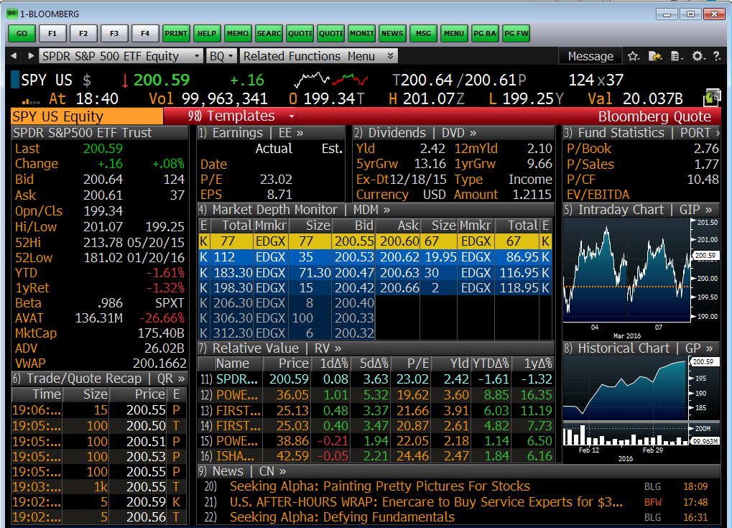
Trading Basics
Important Terms
Last Price
Last traded price is often used in both private and public value as a valuation tool
Bid, Bid Size (x100)
Ask, Ask Size (x100)
52-Week High/Low
Beta
Correlation to the market
Average Daily Value (ADV)

Slide 41
BUY/SELL vs. SHORT/COVER
Everyone understands the concept of BUYING a stock and receiving a positive return if it appreciates in value. E.g. buying 100 shares of GOOG for $100 and SELLING it at $200 would yield a profit of $100 per share (in this case, you own 100 shares), for a total profit of $10,000.
SHORTING is the opposite phenomenon where you first sell and buy later. This is naturally confusing but there exists a pool of stock owners who will LEND you their stock as long as you promise to eventually return it. In this case you would SHORT 100 shares of GM for $50 and then BUY TO COVER (or simply COVER) the shares at $25 per share. Your profit would be $25 per share, or $2,500, in this case.

Slide 42
Fund Basics
Using a collection of stocks (also known as a portfolio), fund managers create funds intended to outperform each other
Two general approaches are passive (or index) and active investing
Passive investing involves selecting a pre-determined portfolio of stocks according to a list or metric
Example: S&P 500, Russell Mid-Cap Index
Active managers attempt to select their securities based on their potential ability to outperform their “benchmark” passive index using skill
Some funds can short, invest in private securities and conduct other advanced operations
Mutual fund
Hedge fund
VC fund
PE fund

Slide 43
Portfolio Construction
Market Neutral
No market exposure – long and short an equal amount
THIS IS NOT THE CONSENSUS
The consensus is to be long-biased
Long = you own the stock (buy first, sell later)
Short = you are the short (sell first, buy later)
Long-Biased
Popular due to the belief that stock prices go up over time
Universe
List of securities that we will focus on
Sector-focused (tech, healthcare, energy)
Market-cap focused (small cap, medium-cap or large-cap)
Style-focused (growth vs. value)
Geographical (U.S. vs. Global)

Slide 44
Portfolio Construction (Part 2)
Shkreli’s First Rule – Realistic Expectations
For every 10 stocks you look at, in general:
8 will be fairly valued by the market
1 will be overvalued by the market
1 will be undervalued by the market
CONCENTRATION VS. DIVERSIFICATION
Concentration → as few stocks “as necessary” and as large as possible % investment in those positions
Buffett’s first partnership WEB had just 3 stocks
Diversified → as many stocks “as possible” and as small as realistic % investment in those positions

Slide 45
Portfolio Construction (Part 3)
You don’t need to invest if you don’t have good investment ideas
No one is forcing you to make a bet
No third strikes in investing – Buffett
Turnover & IRR
We want our investments to work as quickly as possible
There is no such thing as an investor who would prefer to wait years, even if that investor is a “long-term” investor
Shkreli’s Conjecture
As time→0, alpha→0
As time→inf, alpha→inf

Slide 46
IRR Details

Slide 47
Portfolio Monitoring
Drawdown
Peak-to-trough loss should be constantly monitored
Just because you were up 100% for 3 years in a row does not excuse you from a 50% loss in year 4!
Stop-Loss
Absolute portfolio stop-loss of 10%-20% is reasonable
Reassess whether this is for you, start again in 3-6 months
Diagnose what happened: bad skill, bad luck, too much risk, etc.?
Individual position stop loss
Concentration Rules
No investment should be more than x% of portfolio (usually 5-10%)

Slide 48
Sample Portfolio
Long
Microsoft (7%), IBM (6%), Facebook (5%), Oracle (5%), Alarm.Com (3%), SAP (3%), Tata (3%), Alibaba (3%), Softbank (2.5%), Baidu (2.5%), Canon (2.5%), Wipro (2%)
Total “gross long exposure” = 44.5%, or $44,500,000 of a $100,000,000 portfolio
Short
AT&T (7%), Apple (6%), Amazon.Com (5%), Intel (5%), Cisco (3%), Google (3%), Salesforce.com (3%), Nokia (3%), Infosys (3%), Qualcomm (2.5%), VMWare (2.5%), Applied Materials (2%)
Total “gross short exposure” of 45.0% or $45,000,000 of a $100,000,000 portfolio
This is a “market neutral” portfolio with 89.5% “gross exposure” and -0.5% “net exposure”

Slide 49
Stocks in Foreign Companies
“Local Shares”
Shares that are traded on a local exchange
Example: Roche, Nestle, Novartis (NOVN VX) etc.
Local shares are always traded in local currencies
ADRs (American Depository Receipts)
Alibaba, Novartis (NVS)
ADRs often have a ratio of 1:1 (1 ADR:1 local share—but not always!!!)
Level 1 ADR – sponsored by the company
Level 3 ADR – not sponsored by the company, the company does not make American filings

Slide 50
Equities Over The Long-Term
It is my contention that equities do not rise over the long-term, as opposed to conventional wisdom
Our study found, at best, U.S. equities deliver +2% (performance net of taxes and inflation) but harbor substantial survivorship bias

Slide 51
Wall Street

Slide 52
Buy-Side, Sell-Side, Investment Banking
“BUY-SIDE” or simply “INVESTORS”
“SELL-SIDE” or “INVESTMENT BANKS”
Mutual Funds (LONG-ONLY) Fidelity Wellington
State Street
Putnam Capital Research
Hedge Funds Renaissance
Och-Ziff
Citadel
Millennium
Oaktree
Paulson
Securities Research
Buy and sell “recommendations” on securities
Investment Banking
Lending
M&A Advice
Underwriting
Securities Services
Prime Brokerage
Trading
Bank of America
Citigroup
Credit Suisse
Deutsche Bank
Goldman Sachs
JPMorgan
Morgan Stanley
RBC
Wells Fargo
Other
Pension Funds, Insurance Companies, Corporate America, Sovereign Wealth, Individuals

Slide 53
Stock Recommendations…
…are worth ignoring no matter who they come from
They’re not worthless—but you can spend your time more efficiently reaching an independent opinion
DO NOT LOOK AT
Investment bank opinions
Other investors’ opinions
Investment fund’s holdings – INCLUDING “shareholder activism”
DO
Look at as many securities as you can
Learn lateral skills
Win the long-short game of how to use your time. Shorting others’ thoughts and long your own

Slide 54
Hedge Funds Overview
Typically structured as “Limited Partnerships” or LP entity
Typically formed in both Delaware (onshore) and typically in the Caribbean (offshore)
Most hedge funds charge a management fee as well as a performance fee
Mutual funds typically only charge a management fee
For example, if a hedge fund returns 20% on its $100 million in investments in a given year, and has a 2% management fee and a 20% performance fee:
$20 million in gross profits for investors
$2 million in management fees (2% X $100,000,000)
$4 million in performance fees (20% X $20,000,000)
GROSS RETURN of 20% and NET RETURN of 14%
HEDGE FUND FEES GREATLY IMPACT PERFORMANCE – Management fees are independent of profits while performance fees require profits

Slide 55
Hedge Funds Overview
Hedge funds typically report results monthly
Most hedge funds have a goal of not having a year of losses
This expectation has changed dramatically—the “good old days” of Soros, Steinhardt, Tiger, etc. are over
Hedge funds try to avoid “beta”—aka exposure to the market—investors can buy beta without fees through other instruments (SPY)
They often fail at this
Hedge fund investors typically have limited liquidity with substantial restrictions in their ability to withdraw funds
Generally governed by various legal documents

Slide 56
Hedge Funds Today
More focused on fees than performance (makes sense!!!)
Pedigree important predictor of success
More involved in private equity
2011-2020: source of extra alpha?
Activism no longer a source of alpha?
2000-2010: source of extra alpha?

Slide 57
Renaissance Technologies
Renaissance’s Medallion Fund is probably the most successful fund of all time
Fully automated (computerized) and quantitative
Mean-reversion, Hidden Markov Model (Baum-Welch), HFT
Dr. Jim Simons, founder of Renaissance
Started fund at 40 years of age
Assets under management (Form ADV): $43,297,173,710
Latest reported equities holdings (13-F): $45,891,877,000
40-80% annualized gross returns since inception?
+98% in 2008 (after a 40% fee)
290 employees
Mostly PhD mathematician/scientist background

Slide 58
Steinhardt Partners
Variant Perception, Careful risk management, Greater Fool Theory, Information Arbitrage, Wall Street Arbitrage, Macro/Net Short
$7.7 million initial capital in 1967
30% average annual returns for 28 years
“No Bull”
Steinhardt Process 1. The Idea 2. The Consensus View 3. His Variant Perception 4. Trigger Event

Slide 59
Bridgewater
Largest hedge fund in the world ($150bn AUM)
Founded in 1975 in NYC apartment by Ray Dalio
“Macro” style hedge fund—does not trade stocks
“Radical transparency”, “principles”, etc.
Risk parity
https://www.aqr.com/~/media/files/papers/aqr-understanding-risk-parity.pdf
$45,000,000,000 in total cumulative gains since inception (#1)

Slide 60
Tiger Complex
Julian Robertson’s Tiger
Original fund closed in 1980-2000, +31.7% CAGR over 20 years
New fund Tiger Technology → Tiger Global (Chase Coleman)
Original “Tiger Cubs” → Maverick, Lone Pine, Viking
Value-focused, equities-focused & macro-focused fund
Invest in people
6 things to look for: functional intelligence, ethics, sports, charity, sense of humor, resume
Younger people, often right out of college
Decentralized management from time to time??? Viking
Sole trigger puller from time to time??? Lone Pine
http://www.books.mec.biz/downloads/Julian_Robertson_A_Tiger_in_the_Land_of_Bulls_and_Bears/NzAyOTExODM5

Slide 61
Tiger Management
Julian Robertson
1980-2000
Lone Pine
Stephen Mandel
2000-Present
Viking
Andreas Halvorsen
Maverick
Lee Ainslie
Blue Ridge
John Griffin
Deerfield
Arnold Snider
Coatue
Phillipe Lafonte
Conatus
David Stemerman
Impala
Bob Bishop
Bridger
Roberto Mignone
JAT
John Thaler
Tiger → SAC →
Samlyn
Rob Pohly
Healthcor
Art Cohen
Shumway
Chris Shumway
Bowman
Larry Bowman
Intrepid
Steve Shapiro
North Sound
Tom McAuley

Slide 62
Viking Global Investors
Andreas Halvorsen, former senior manager at Tiger
Former competitive skier, Norwegian Navy Seal
$33B AUM, 148 employees, 50 investment-related
18% net returns since inception 1999-Present
Two down years, both -0.9%!!!
Equity-focused
Doesn’t shy from global, illiquid/private/VC
Concentrated
Value investor, but understands “growth stocks” (see Lone Pine)
Team-run
Low-net (net exposure)

Slide 63
Lone Pine
Stephen Mandel
$26B, 93 employees, 1997 launch, equities-only, some long-only
+25% average annual returns since inception
Values and invests in high-growth companies better than anyone
Largest holder of Google at IPO!
Shorts disrupted companies like retailers
Q216 13F: PCLN, DLTR, FB, AMZN, STZ, CHTR, NKE all over $1bn
18 analysts – Steve is the only “trigger puller”/PM

Slide 64
Warren Buffett
GOAT
Similar to “Annus Mirabilis” of Einstein, Buffett introduced the following concepts:
Use/abuse of float-generative businesses
Private equity as the ultimate arbitrage
Moats result in close-to-zero discount rate
Image/reputation
Graham & Dodd

Slide 65
Macroeconomics
What an investor needs to know

Slide 66
Inflation
Probably the most important concept as it ties discount rates to a firm reality
Measures of inflation
PCE
CPI, PPI
Not terribly accurate as inflation in its broadest sense must account for the price of everything – an investor isn’t terribly concerned with the price of a quart of milk
Sovereign bond prices of large countries with no default risk

Slide 67
Asset Class Long-Term Prices
US Public Equities
After inflation and taxes, excess return on US equities are minimal
Post hoc ergo propter hoc fallacy – “the good times are permanent, the bad times don’t count”
Bonds
Real Estate
Commodities

Slide 68
GDP and other Economic Measures
Total amount of goods and services produced in a period, but what does it really mean?
Per-capita adjustment
Revisions
Calculus
Short-term, transactional nature
Housing Starts, U. Mich Survey, Philly Fed, Durable Goods, ISM

Slide 69
Employment
Employment has been one of the best indicators of economic health
Some change to this given disruptive technologies in the US
Still holds for most other countries
Pay careful attention to how everything is calculated
Job reports from BLS

Slide 70
Credit
Federal Reserve
Federal Funds Rate, QE, TARP, etc. all ways to control the money supply
Money Supply
Broad concept of supply/demand of money
“M” measurements
Yields
Sovereign, TIPS/”real”
Corporates
Mortgages, Munis

Slide 71
Instruments
Yield Curve, Interest Rate Trades, Libor, Eurodollar
2v10s (steepner, flattner)
Swaptions
http://www.icap.com/what-we-do/global-broking/~/media/Files/I/Icap-Corp/pdfs/icap-interest-rates.pdf
http://www2.gsu.edu/~fncgdg/material/Swaps.pdf
Credit Spreads
Low-rated vs. high-rated vs. sovereigns
CDS, CDO/CLO, MBS, CMBS, ABS, Cat Bonds
Futures – Equity, Commodity, Weather
Currency
USD/EUR, USD/JPY, USD/basket
Typical relationship is direct with inflation (see USD/GBP in 1980s) due to “carry trade” phenomenon
Exotics, Volatility, Swaps

Slide 72
Macro Funds
Advantages: Liquidity, Talent
Disadvantages: Few unique ideas
Example Macro Funds
Bridgewater
Soros
Moore
Caxton
Tudor
Joe Lewis

Slide 73
Entrepreneurship (Starting a Company)

Slide 74
Bibliography
Common Stocks and Uncommon Profits – Philip A. Fisher
Information Arbitrage basics
Barbarians At The Gate (Bryan Burrough)
Den of Thieves (James Stewart)
The Smartest Guys In The Room (Bethany McLean)
Confidence Game (Christine Richard)
Fooling Some of the People All of the Time (David Einhorn)
Trading to Win (Kiev)
The Money Masters
Autobiography
No Bull (Michael Steinhardt)
Snowball (Alice Schroeder)
Principles (Ray Dalio)
Confessions of a Street Addict (Jim Cramer)

